Slide 1
Bank Insights

Slide 2
INTRODUCTION
Mitron bank is a financial institution having headquarter in Hyderabad.
They want to introduce a new line of credit cards , aiming to broaden its product offering and reach in the financial market.
They had their customers in across five cities.
AtliQ data services know about this and approached to the bank with a proposal to implement this project.
Strategy director , Mr. Bashin Rover provide dataset of 4000 customers and asked them to do this pilot project first.

Slide 3
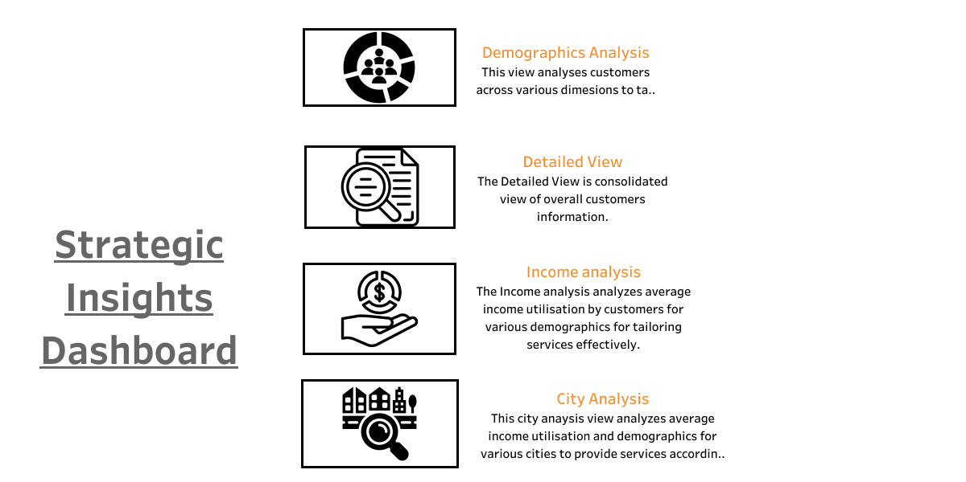

Slide 4
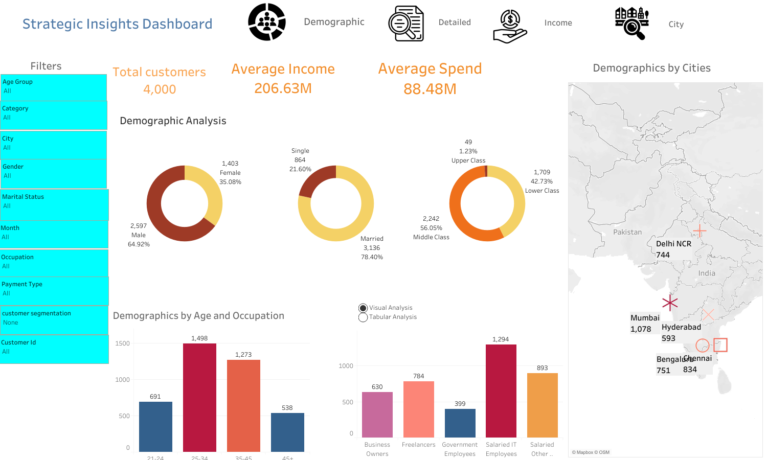

Slide 5
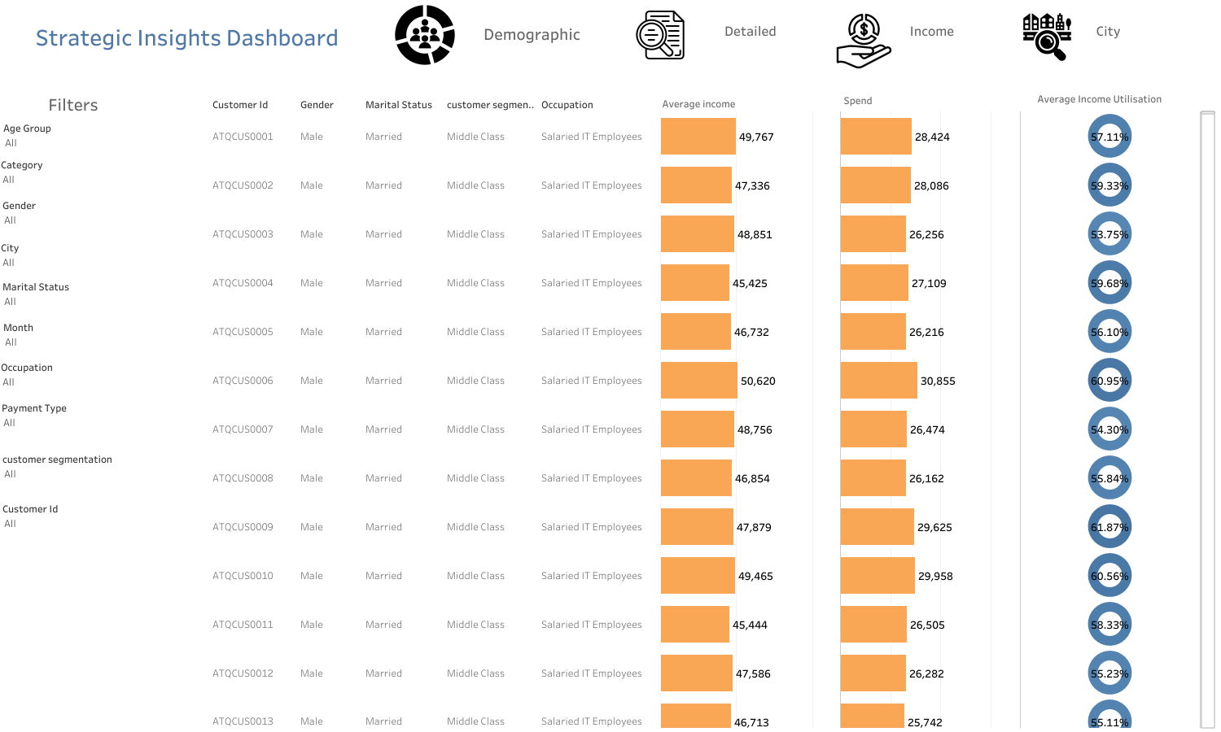

Slide 6
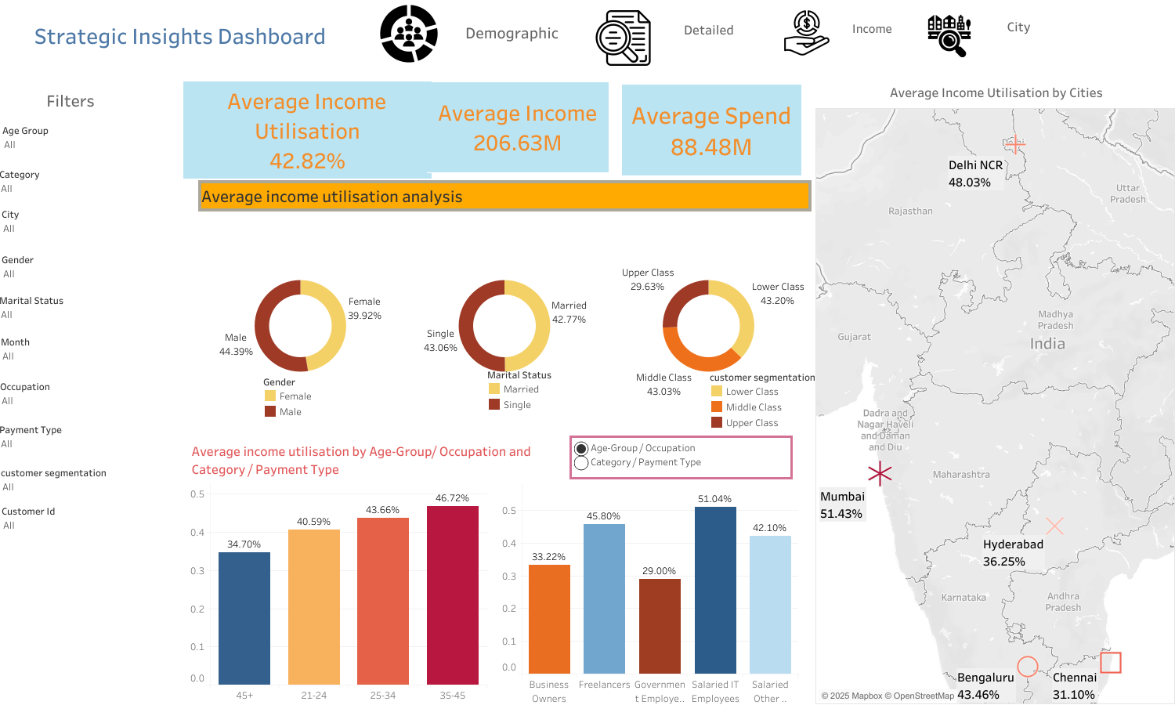

Slide 7
